Slide 1
Project of Big Data Analisys
Using secondary Mushroom dataset

Slide 2
Dataset
It includes 61069 hypothetical mushrooms
The caps are based on 173 species (353 mushrooms per species).
Each mushroom is identified as definitely edible or poisonous.
It is characterized by 20 features, divided in numerical and categorical types
The two classes have almost equal distributions
The given information is about the Secondary Mushroom Dataset

Slide 3
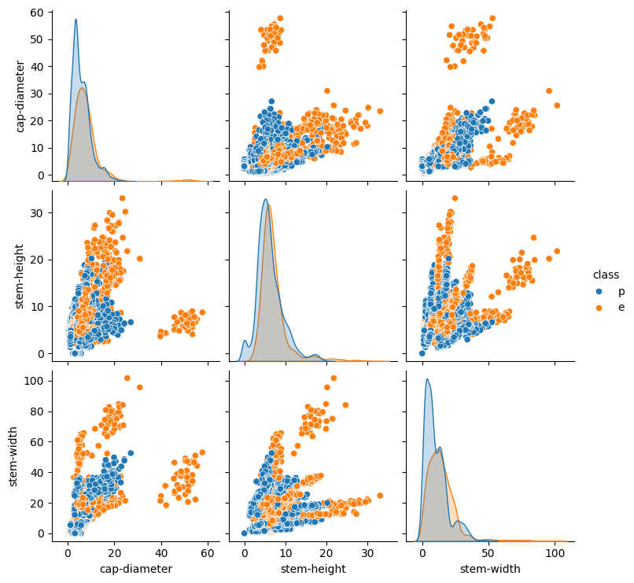
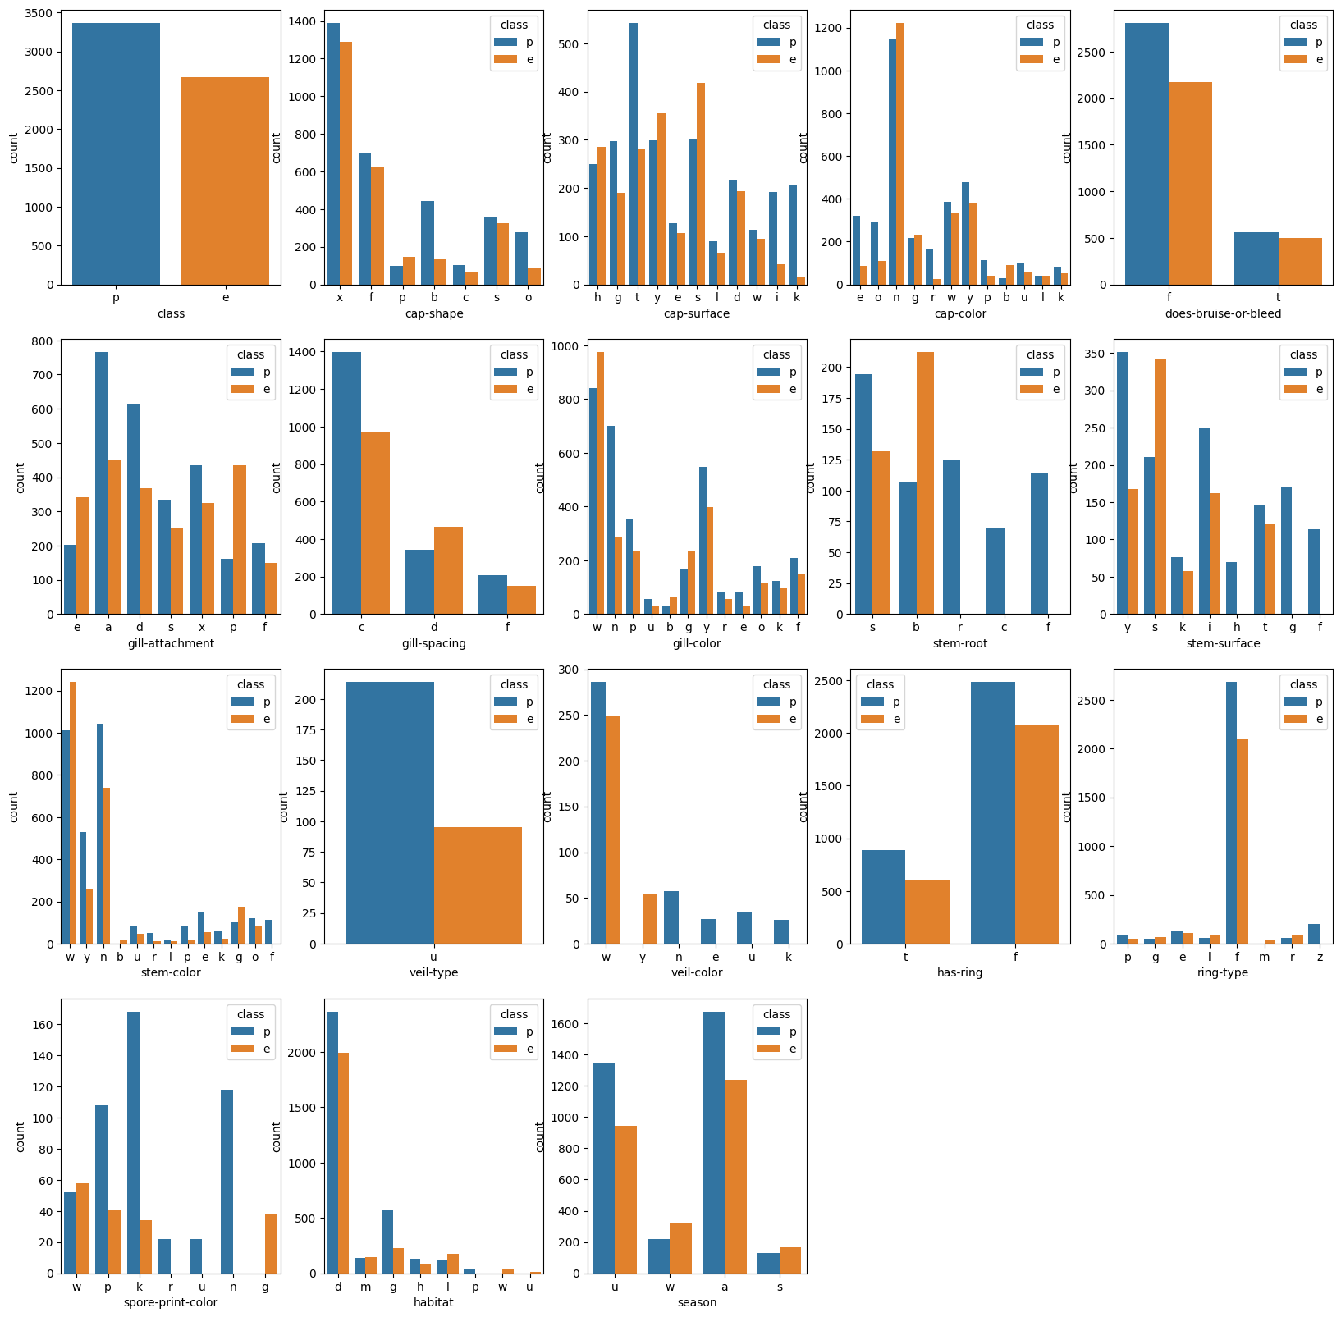
Dataset description

Slide 4
Docker and Spark setup
The Docker image is built upon the official Spark image.
We install all the dependencies needed for the task.
It runs a Linux enviroment.
The Spark session is created through a Jupyter notebook.

Slide 5
Data pre-processing
Removal of row duplicates.
Omission of columns with the number of Null/NaN greater than 50% of the total number of rows.
Replacing of the remaining Null/Nan with the most frequent value in each column.
Use of the R-Formula to transform the dataset.
All the remaining columns are considered as features.
We split the transformed dataset into train and test sets.
The objective of the pre-prosessing is to enhance the quality of the data in order to achieve better results

Slide 6
Metrics and Cross-validation
We define specific custom functions for the computations of the metrics (Accuracy, F1, F2, AUC ROC).
They take the labels and the predictions and return the scores.
Since it is a binary classification problem, the AUC ROC is the main metric for the evaluation of the performances, and for this reason we also plot the curve on a graph.
We use the MLlib cross validator to evaluate the model robustness, combined to a parameter grid for the optimal tuning.
The 10-fold cross validator is used to generate 10 training and testing pairs.
The metrics are used to evaluate the performances of the models, while the cross-validation is used to find better hyperparameters and to evaluate models robustness

Slide 7
Models
Gaussian Naive Bayes:
Uses the principle of Naive Bayesian probability to make predictions by combining prior knowledge with observed evidences.
It is Naive because it assumes indipendences between the features of the dataset.
The smoothing handles the problem of zero probability. The best value for this parameter is found to be 1.0.
Logistic regression:
Is a supervised learning algorithm that makes use of logistic functions to predict the probability of a binary outcome.
regParam is a regularization parameter that controls the strength of regularization applied to prevent overfitting .
elasticNetParam combines L1 and L2 regularization techniques. It balances the two by controlling the mix between them.
Best values: regParam = 0, elasticNetParam = 0.5.
We tried multiple models architectures to see which one would have the best performance

Slide 8
Models
PCA-Logistic Regerssion:
Principal Component Analysis (PCA) is a statistical technique used for dimensionality reduction. It transforms a set of correlated features into a set of linearly uncorrelated variables called principal components.
The components are ordered by the amount of variance they capture from the original dataset, allowing for simplification with minimal loss of information.
We used a logistic regressor to test if the new features had comparable results.
Random Forest:
A Random Forest is an ensemble machine learning algorithm that combines multiple decision trees to make more accurate and stable predictions.
Uses bagging and feature randomness when building each individual tree to create an uncorrelated forest of trees whose prediction by committee is more accurate than that of any individual tree.
We used 100 trees with the best values for max depth equal to 10 and max bins equal to 40.
We tried multiple models architectures to see which one would have the best performance

Slide 9
Models
Decision Tree:
A Decision Tree is a machine learning algorithm that models decisions and their possible consequences as a tree-like structure.
It splits data into branches at decision nodes based on feature values, leading to leaf nodes representing outcomes or class labels.
Best values: Max Depth = 10, Max Bins = 10
Gradient-Boosted Tree:
Gradient Boosted Trees (GBT) is an ensemble machine learning technique that builds a series of decision trees sequentially, where each tree tries to correct the errors of its predecessor.
It utilizes a gradient descent algorithm to minimize the loss function, effectively improving prediction accuracy with each iteration.
Best values: Max Depth = 10, Max Bins = 20.
We tried multiple models architectures to see which one would have the best performance

Slide 10
Models
One-vs-Rest Gaussian Naive Bayes:
One-Vs-Rest (OvR), also known as One-Vs-All, is a strategy for multi-class classification that involves training a single classifier per class, with the samples of that class as positive samples and all other samples as negatives.
This approach essentially decomposes a multi-class classification problem into multiple binary classification problems, one for each class.
The best value for the smoothing parameter is found to be 1.0.
This method is used as a control of effectiveness of the other classifiers
We tried multiple models architectures to see which one would have the best performance

Slide 11
Results
Classifier | Accuracy | F1 | F2 | ROC
Gaussian Naive Bayes | 0.625114 | 0.693344 | 0.829687 | 0.691138
Logistic Regression | 0.77535 | 0.752913 | 0.763761 | 0.849205
PCA-Logistic Regressor | 0.557984 | 0.122288 | 0.0838972 | 0.631083
Random Forest | 0.968132 | 0.96384 | 0.959675 | 0.997041
Decision Tree | 0.90423 | 0.899939 | 0.940902 | 0.878202
Gradient-Boosted Tree | 0.998179 | 0.997949 | 0.997949 | 0.999964
OvR Gaussian Naive Bayes | 0.625114 | 0.693344 | 0.829687 | 0.691126
The results are comparable with those obtained on the paper used as a guideline
The models based on trees performed well above the others.
They are particularly effective in modeling non-linear relationships between features and labels.
They tend to be less sensitive to outliers compared to other methods like logistic regression.

Slide 12
Project Work

Slide 13
Models
MultiLayer Perceptron:
MultiLayer Perceptron (MLP) is a feedforward artificial neural network model which maps sets of input data onto a set of appropriate outputs.
It consists of multiple layers of nodes in a directed graph, with each layer fully connected to the next one.
The blockSize parameter is used to tune the performance of the algorithm during training. By dividing the dataset into blocks, the algorithm can leverage Spark's distributed computing capabilities more effectively. The best value for this parameter is found to be 256.
Linear Support Vector Machine:
SVM works by finding the hyperplane that best separates two classes in the feature space with the maximum margin.
It ensures the greatest distance between the hyperplane and the nearest data points of each class (support vectors).
Best values: Max Iterations = 100.
We tried multiple models architectures to see which one would have the best performance

Slide 14
Models
Factorization Machine:
Factorization Machines are a versatile supervised learning algorithm that efficiently capture interactions between features in high-dimensional sparse datasets.
They generalize matrix factorization and linear regression, modeling not only linear relationships but also interactions between pairs of features using factorized parameters.
Best values: Max Iterations = 100.
We tried multiple models architectures to see which one would have the best performance

Slide 15
Results
Classifier | Accuracy | F1 | F2 | ROC
MultiLayer Perceptron | 0.786028 | 0.792786 | 0.865691 | 0.834693
Linear SVM | 0.781641 | 0.762428 | 0.778411 | 0.838108
Factorization Machines | 0.961841 | 0.956872 | 0.954995 | 0.993067
Factorization Machines are the best performing models
They are designed to model interactions between any two features efficiently. This is especially useful in binary classification tasks where the relationship between features is not just linear but also involves interactions that can be critical for making accurate predictions.
They generalize various factorization models (like matrix factorization) and combine them with linear models. This versatility allows them to capture both simple and complex patterns in the data, which is essential for binary classification tasks that can range from straightforward to highly intricate.
The results are comparable with those obtained previously

Slide 16
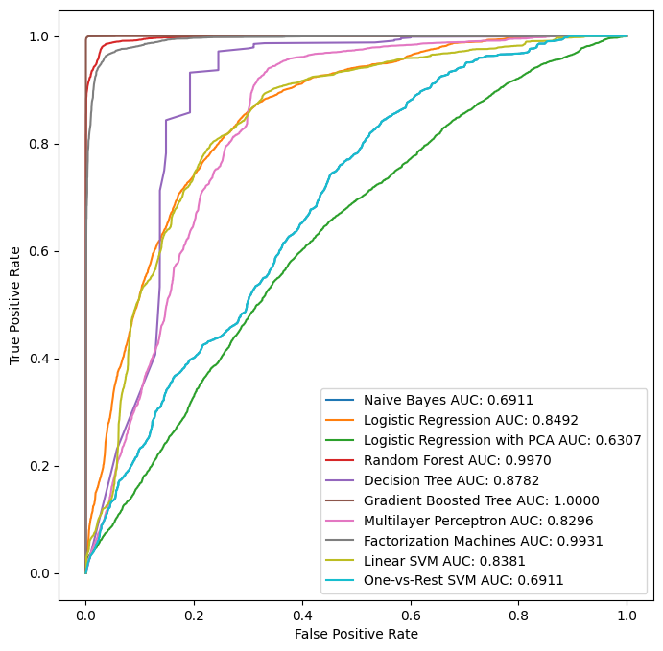
Overall Plots
The ROC curves of the models

Slide 17
The end

